Slide 1
Programming 1 - WEEK 4
Skills

Slide 2
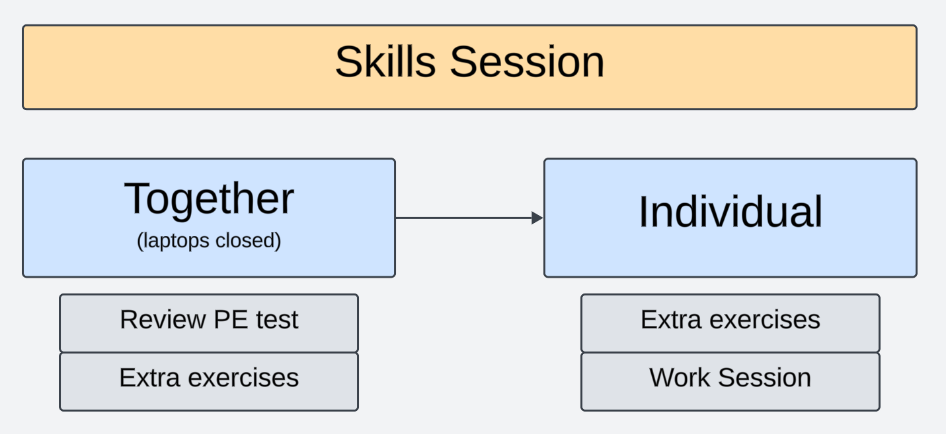
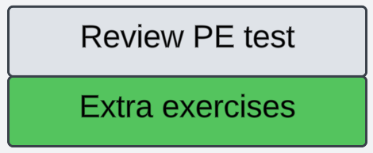
Approach

Slide 3

Savings
Take into account the following parameters: an investment amount, an annual interest rate as a percentage, and a target amount. Write a function called years_to_target that accepts these three parameters and returns the number of years required to reach your target amount.
Example:
years_to_target(500,5,1000) = 15

Slide 4
Count vowels
Write a function count_vowels(text) that returns the number of vowels in the parameter text.
Tip: we consider a, e, i, o, u and y to be vowels
Example:
text = “You look good today!”
count_vowels(text) = 10

Slide 5
String manipulation
Write a function remove_double_spaces(text) that returns a new text value identical to the input parameter text but with all double spaces replaced by single spaces.
Example:
text = “ Hello there ! “
remove_double_spaces(text) = “ Hello there ! “

